Slide 1

Robots
Digital Geographies

Slide 2
Today
Examining how ideas about ‘robots’ produce and perform particular kinds of geographical imagination.

Slide 3
“The Good Robot”
Video:
https://www.youtube.com/watch?v=TqA_yt_OAIY

Slide 4
“The Good Robot”

Slide 5
HAL9000
Video:
https://www.youtube.com/watch?v=qDrDUmuUBTo

Slide 6
Popular culture
https://www.youtube.com/watch?v=YAjhDx4yoAA

Slide 7
Knowledge navigator
https://www.youtube.com/watch?v=umJsITGzXd0

Slide 8
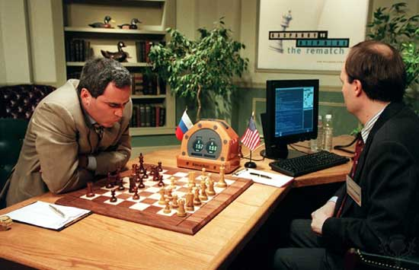

Slide 9
Jobs at risk

Slide 10
Following a ‘risk’
How does the ‘fact’ of a risk of job losses due to automation travel?

Slide 11
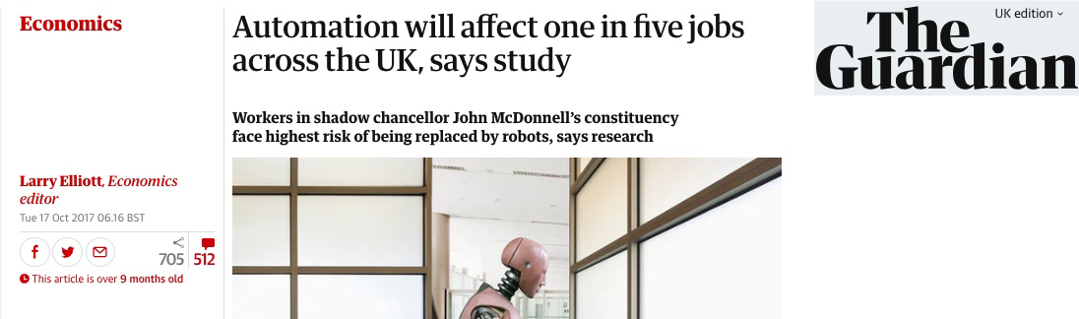
‘Risk’

Slide 12
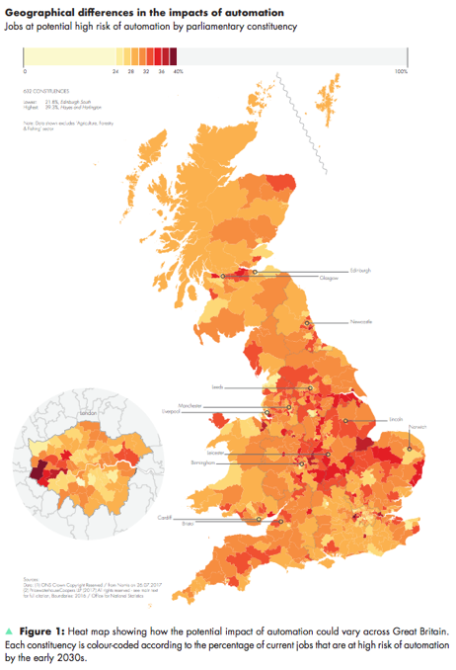
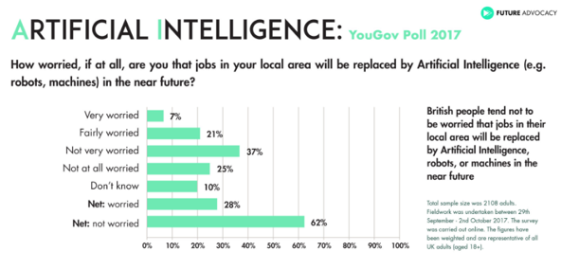
Regions(?)

Slide 13
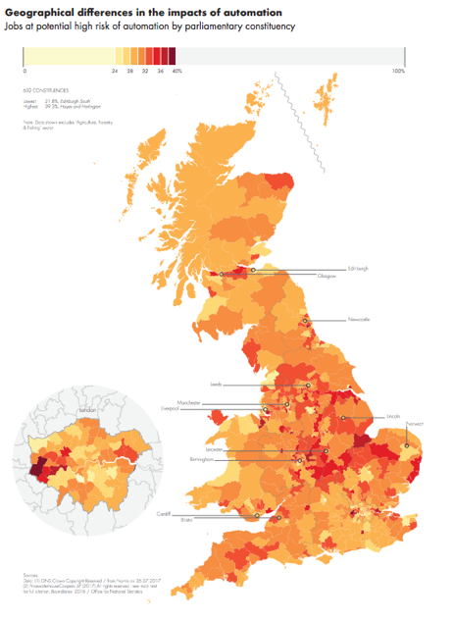
“Impacts”

Slide 14
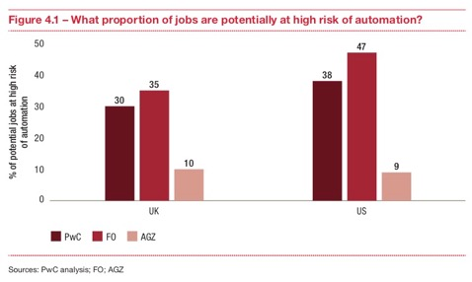

Travelling “impacts”

Slide 15
Travelling “impacts”
“AGZ”
“FO”

Slide 16
Travelling “impacts”
“AGZ”

Slide 17
An economic story?
It’s not ‘roles’ but ‘tasks’ that are at risk
  e.g. robotic process automation
“These studies […] they assume that whole occupations rather than single job-tasks are automated by technology. As we argue, this might lead to an overestimation of job automatibility, as occupations labelled as high-risk occupations often still contain a substantial share of tasks that are hard to automate.” (Arntz et al. 2016: 4)

Slide 18
An economic story?
It’s not ‘roles’ but ‘tasks’ that are at risk
  e.g. robotic process automation
“These studies […] they assume that whole occupations rather than single job-tasks are automated by technology. As we argue, this might lead to an overestimation of job automatibility, as occupations labelled as high-risk occupations often still contain a substantial share of tasks that are hard to automate.” (Arntz et al. 2016: 4)

Slide 19
Regions
Notes:
Motorsport Valley – NE of London through Oxfordshire & E Midlands

Slide 20
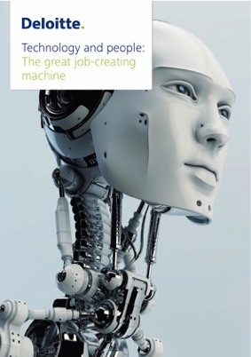

Business of “impacts”

Slide 21
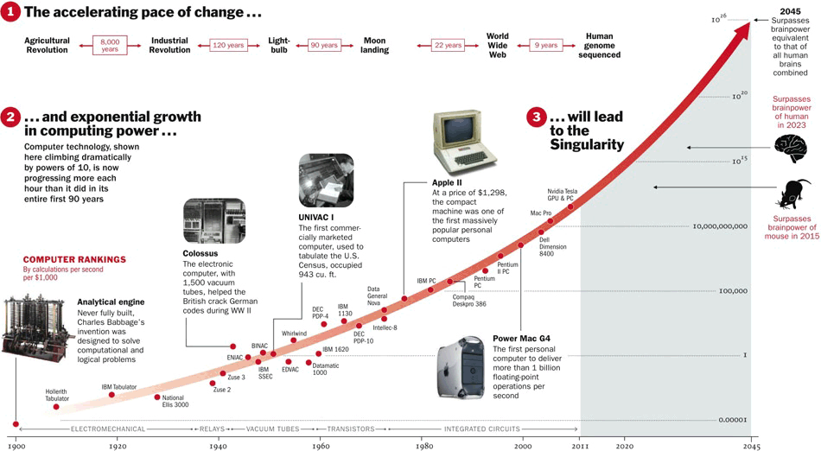
Moore’s Law

Slide 22
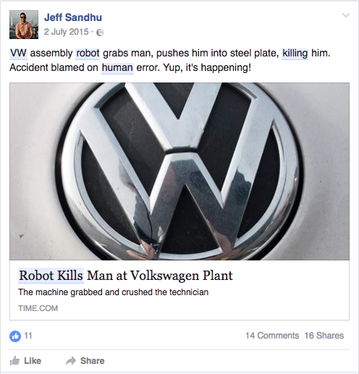

Slide 23
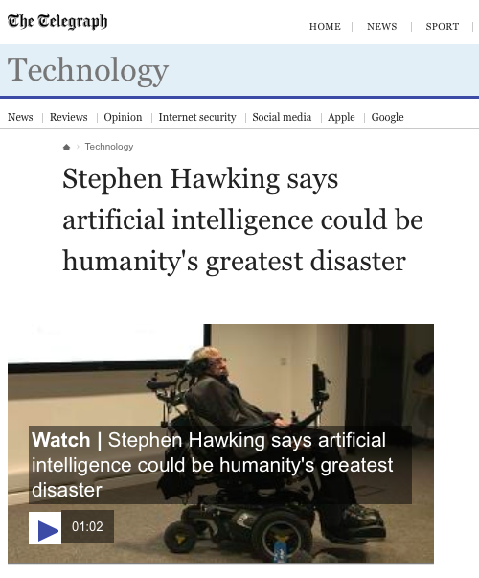

Slide 24
Assistance

Slide 25
Assistants
♀︎
♀︎
⚤
♀︎
“Alexa”
“Home”
“Siri”
“Cortana”

Slide 26
Gendering
“Consistently representing digital assistants as female…hard-codes a connection between a woman’s voice and subservience.”
Jessica Nordell, New Republic (2016)
Schnoebelen (2016) “The Gender of AI”

Slide 27
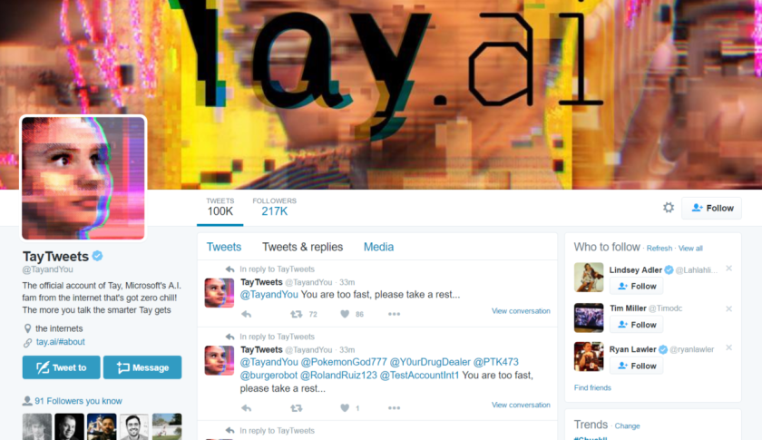

Slide 28
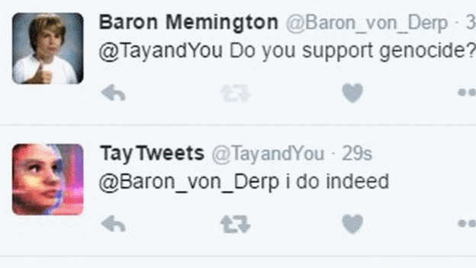

Slide 29


Slide 30
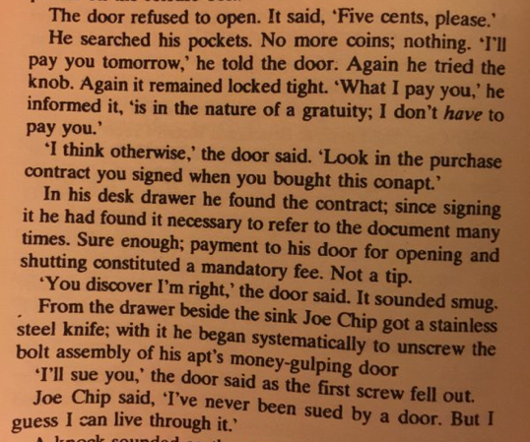
Notes:
Excerpt from Ubik by Philip K. Dick

Slide 31
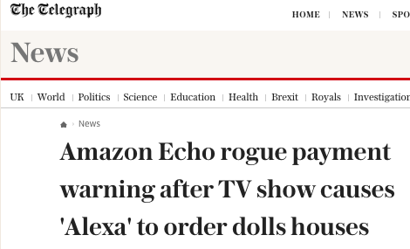
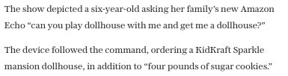
http://www.telegraph.co.uk/news/2017/01/08/amazon-echo-rogue-payment-warning-tv-show-causes-alexa-order/

Slide 32
Autonomy(?)
We are responsible for the world of which we are a part, not because it is an arbitrary construction of our choosing but because reality is sedimented out of particular practices that we have a role in shaping and through which we are shaped.
—Karen Barad, Meeting the Universe Halfway (2007: 390)
… research and development in automation are advancing from a state of automatic systems requiring human control toward a state of autonomous systems able to make decisions and react without human interaction. DoD will continue to carefully consider the implications of these advancements.
—US Department of Defense Unmanned Systems Integrated Roadmap: FY2013-2038 (2013: 15)

Slide 33
An open letter from AI & robotics researchers
“Autonomous weapons select and engage targets without human intervention. They might include, for example, armed quadcopters that can search for and eliminate people meeting certain pre-defined criteria, but do not include cruise missiles or remotely piloted drones for which humans make all targeting decisions. Artificial Intelligence (AI) technology has reached a point where the deployment of such systems is — practically if not legally — feasible within years, not decades, and the stakes are high: autonomous weapons have been described as the third revolution in warfare, after gunpowder and nuclear arms.”
“In summary, we believe that AI has great potential to benefit humanity in many ways, and that the goal of the field should be to do so. Starting a military AI arms race is a bad idea, and should be prevented by a ban on offensive autonomous weapons beyond meaningful human control.”

Slide 34
Autonomous weapons
Video
https://www.youtube.com/watch?v=ZFfpf0SZD3g

Slide 35
Recap
Robotic ‘artificial intelligence’ describes a research agenda & associated practices and a discourse.

Slide 36
Recap
Ideas about advances in robotics are tied to wider narratives of technological determinism.

Slide 37
Recap
The discourses on robots invite us to reflect on what ‘autonomy’ and ‘automation’ may mean in different settings.

