Slide 1
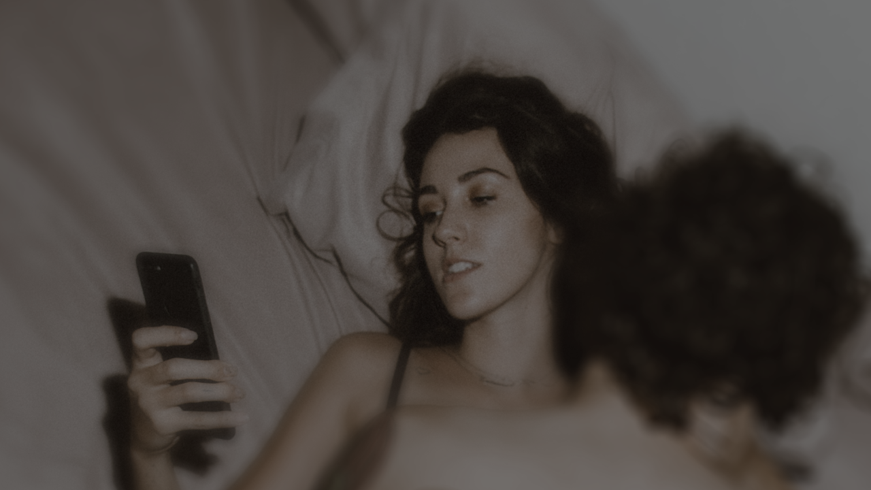
Sex and the digital
Digital Geographies

Slide 2
today
the ways some people use apps and platforms in order to meet others for sex and how this relates to city-spaces
the ways in which our intimate moments are increasingly mediated with and through digital technologies

Slide 3
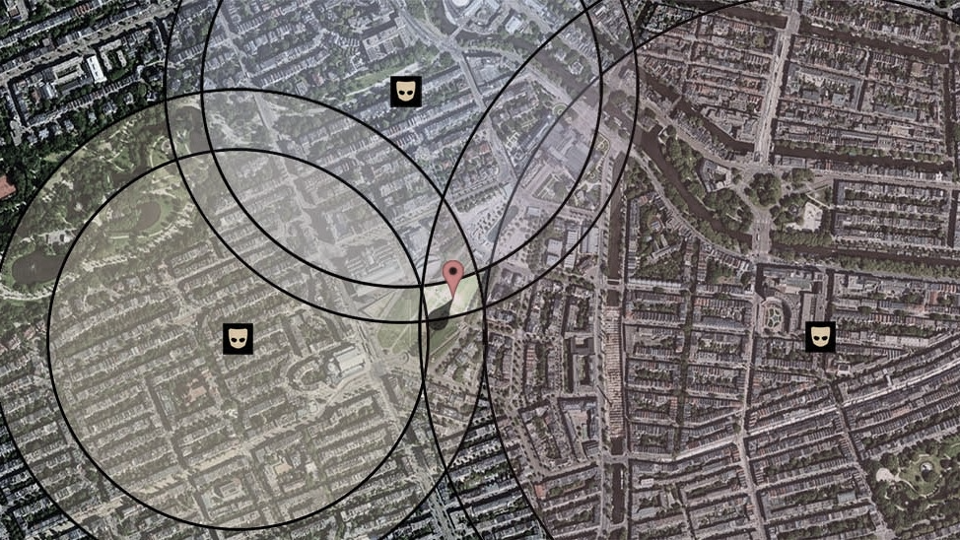
Sex in our cities

Slide 4
Sex in our cities
Long history of sex ‘outside’, as George Michael celebrated
Much of this is associated with men who have sex with other men, but it’s not exclusive
Let’s go outside (let’s go outside),
In the moonshine
Take me to the places that I love best
George Michael, Outside (1998)

Slide 5
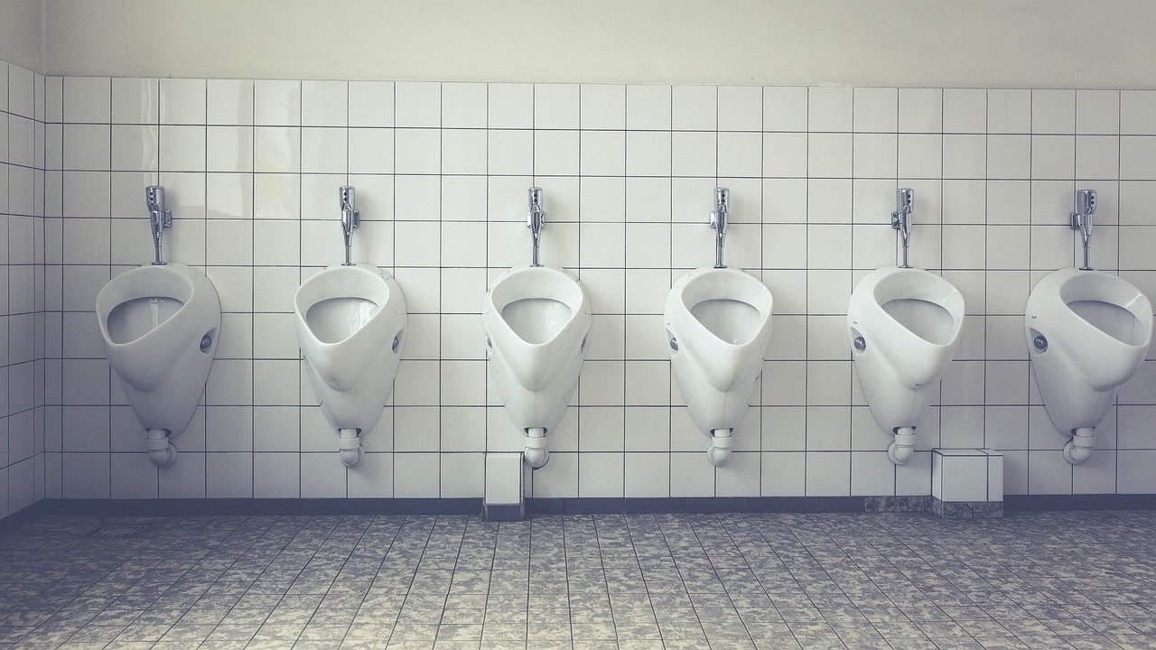

Slide 7
Sex in our cities
‘Gay villages’, ‘gayborhoods’ and the exclusionary spaces and segregated spaces that have so often characterized queer urban life
while cities have constituted—and continue to constitute—spaces of sexual possibility, they are also sites upon which ‘sexuality is most intensely scrutinised’ (Hubbard 2011: xiv).

Slide 8
An app for that
For the LGBTQ app user, Grindr or Scruff or HER can reconfigure any street, park, bar, or home into a queer space by brokering a meeting between mutually attracted individuals.
(Miles 2021: 205)

Slide 9
An app for that
Queer men have long used subcultural codes, from fashion items like a single earring or colored handkerchiefs, to language and slang such as Polari, to assist in identifying each other in public. Now this peer identification is expedited through digital algorithms in users’ pockets and executed in real-time.
(Miles 2021: 210)

Slide 10
Location, location, location
The major attraction of apps such as Grindr, Hornet, and Blued that dominate online socialization for male-male encounter is their GPS mapping function.
(Miles 2021: 208)

Slide 11
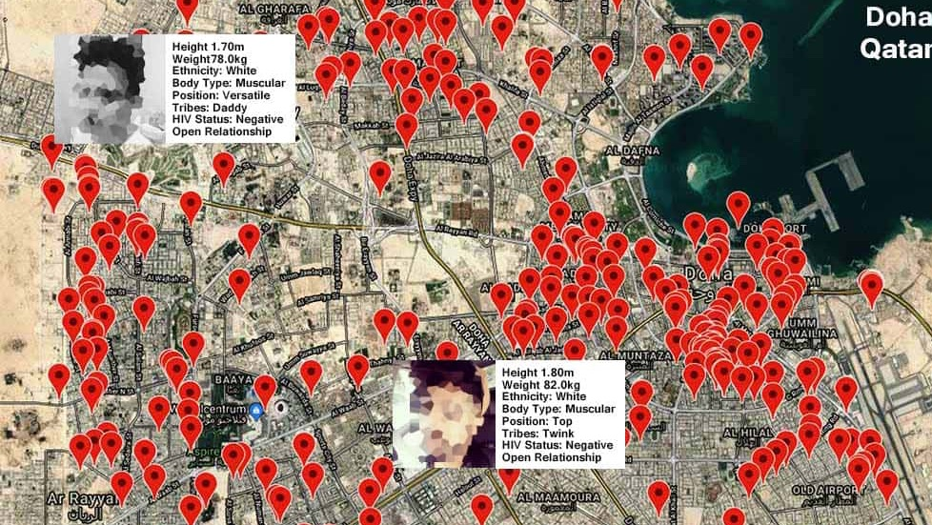
risk

Slide 12
image
masculinities and sexualities are negotiated and produced through the Grindr grid to understand the lived experience of being a man who uses Grindr
(Bonner-Thompson 2017: 1613)

Slide 13
image
Some Grindr users chose to show different parts of their unclothed bodies in their profile pictures. Only certain body parts are able to be exposed in pictures as Grindr have ‘profile guidelines’ that restrict complete nudity. Therefore, users are unable to use naked pictures, or pictures that highlight the shape of their genitals through clothing. The degree of exposure varied, and included, but was not exclusive to, shirtless men, and men in underwear and unbuttoned clothes.

Slide 14
image
Lifestyle masculinities emerge when men who use Grindr seek to (re)construct a digital body that is entangled with everyday and material geographies. The regulatory practices that can shape men’s material bodies – for example, size and shape – work through the productions of masculinities in the Grindr grid.
(Bonner-Thompson 2017: 1619)

Slide 15
Mediating sex

Slide 16
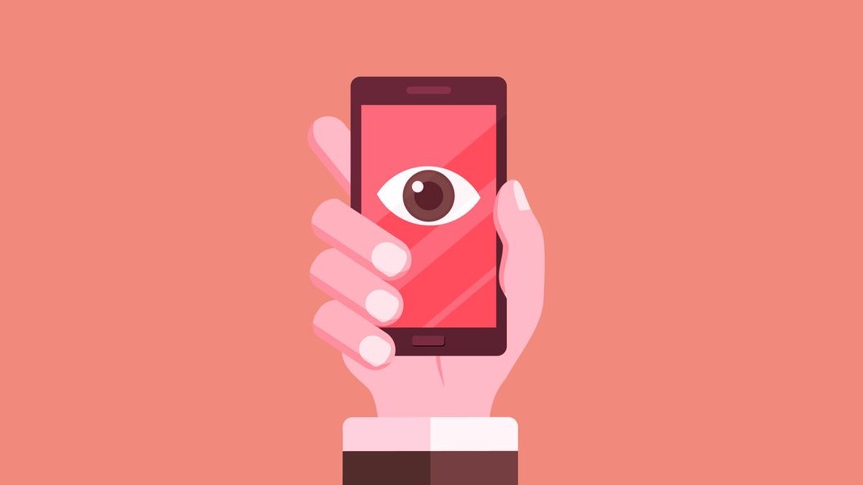

Slide 17
sexting
Video:
https://www.youtube.com/watch?v=V4DenkTtZpg

Slide 18
platform

Slide 19
Sex tech?
Video except from:
https://www.youtube.com/watch?v=qlNV2fx7iS0

Slide 20
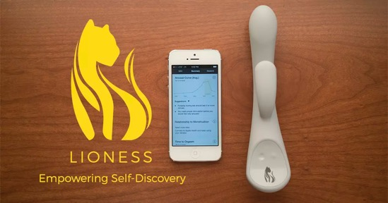
device

Slide 21
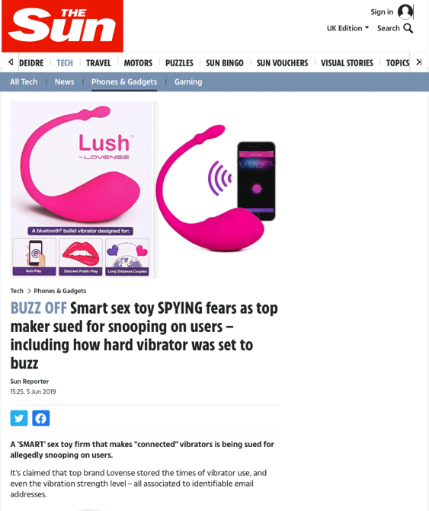

Slide 22
Final thoughts
How we find sexual partners is often mediated by apps
This in turn shapes how we navigate and negotiate public and private spaces

Slide 23
Final thoughts
Our most intimate moments are often mediated by digital technologies, knowingly or not
The capacity to take and share images digitally has had a significant influence on how we understand a negotiate intimacy

