Slide 1
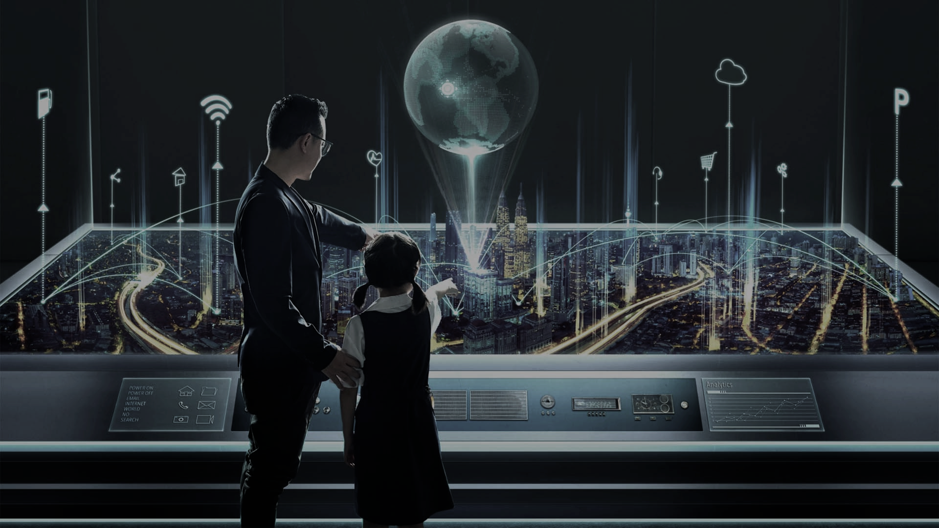
Digital futures
Digital geographies

Slide 2
Today
Exploring the ways digital technology is bound up with ideas about a/the future
Critically examining how such futures are claimed and represented.

Slide 3
Historical context…

Slide 4
Worlds Fairs/Expositions

Slide 5
Technological determinism
Schumpeter’s “Creative Destruction”
Kevin Morgan on innovation.

Slide 6
Industrial imagination

Slide 7
You Will (AT&T)
TV adverts (1993):
https://www.youtube.com/watch?v=a2EgfkhC1eo

Slide 8
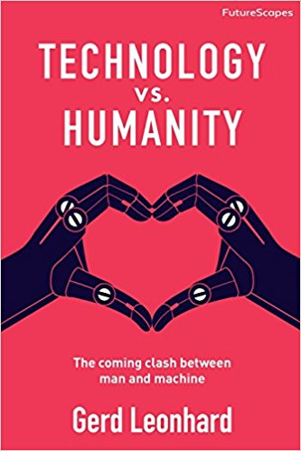
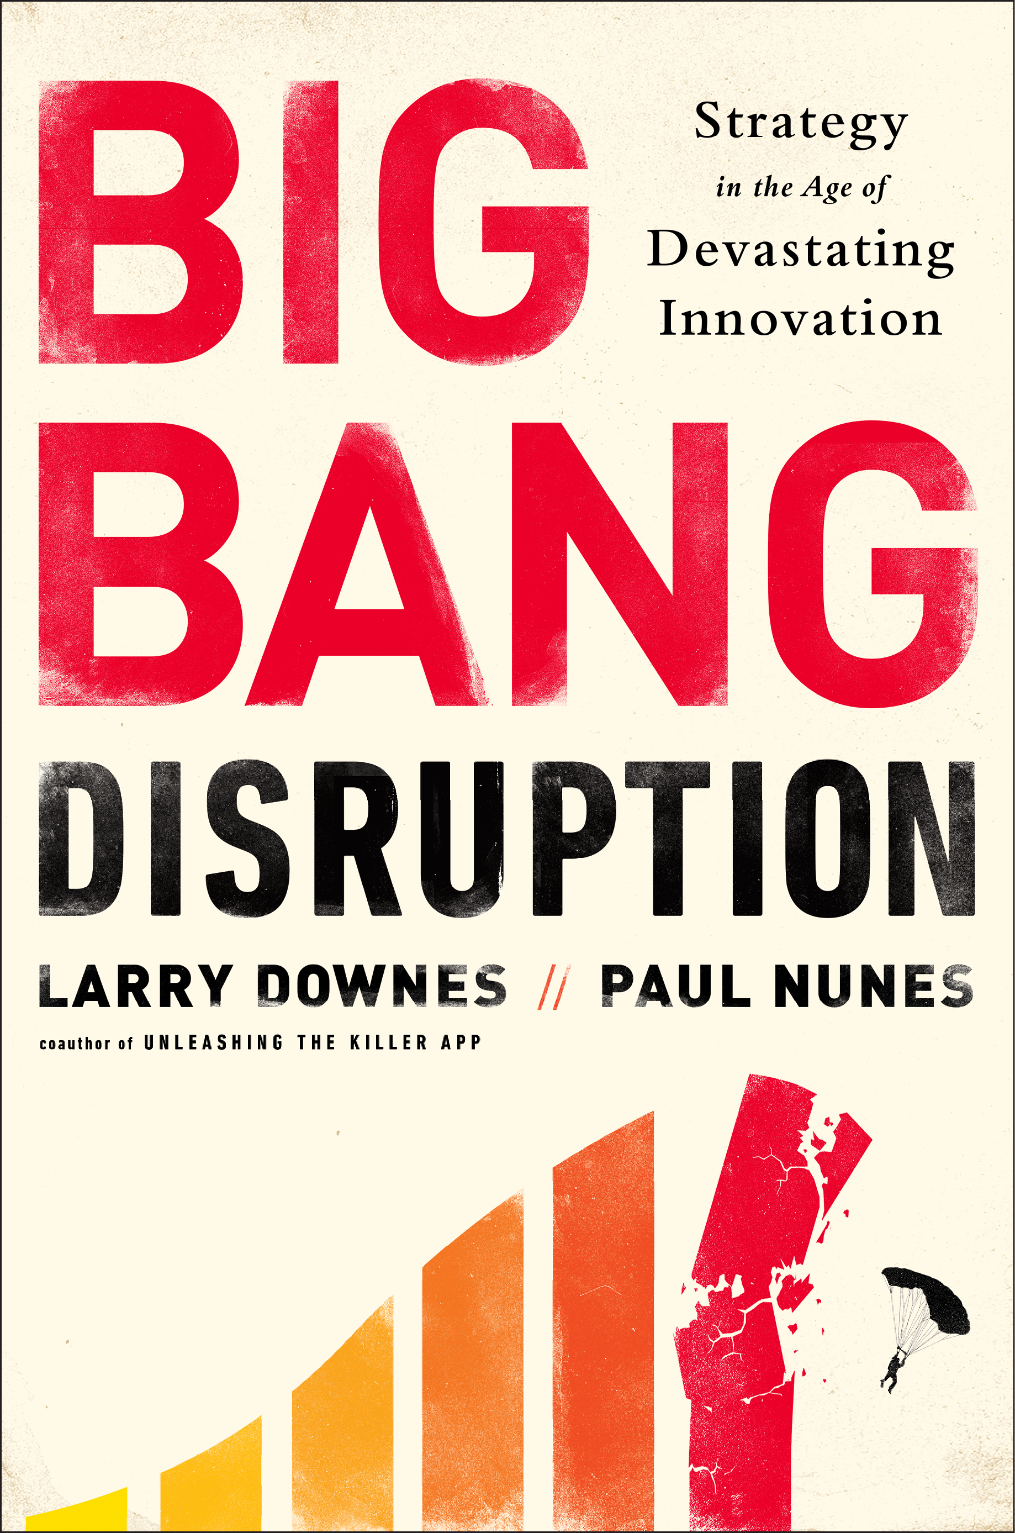
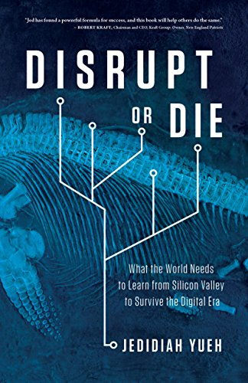
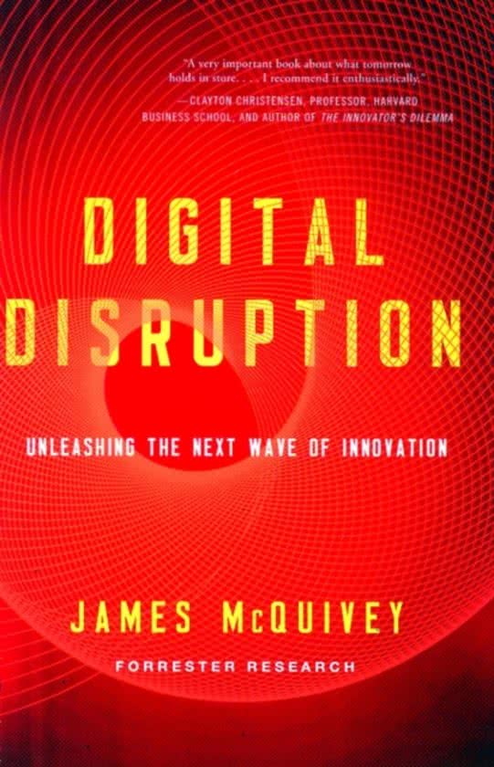
Shocks?

Slide 9
Video:
https://www.weforum.org/videos/20240-the-robots-are-coming-but-they-ll-create-more-jobs-than-they-take

Slide 10
From Science Fiction to Design Fiction

Slide 11
Science Fiction
Representations of our world as it could have been or could be otherwise.
Imaginative geographies of plausible scientific knowledge (e.g. cloning & biotech, digital tech., etc) have given rise to alternative versions of our world.
Combination of plausible with fanciful creates effect of ‘estrangement’ (Kitchin & Kneale, 2001)
Encourages critical reflection upon extreme versions of contemporary spatial processes
urbanisation, neo-liberalism, class stratification, automation etc.

Slide 12
The Circle
A speculative (exaggerated) imagining of Google/Facebook taken to an extreme to explore privacy
‘SeeChange’ cameras ~ panopticon
‘PastPerfect’ family history
“secrets are lies”, “sharing is caring”, “privacy is theft”.

Slide 13
‘Design Fiction’
“whether we like it or not, the fictional technology seen in sci-fi set audience expectations for what exciting things are coming next” (Shedroff and Noessell, 2012: 6)
“the relationship between design, science fiction and the material objects that help tell stories about the future—mostly props and special effects as used in film and other forms of visual stories, both factual and fictional” (Bleecker, 2009: 11)

Slide 14
Minority Report
Movie clip (2002):
http://www.youtube.com/watch?v=NwVBzx0LMNQ

Slide 15
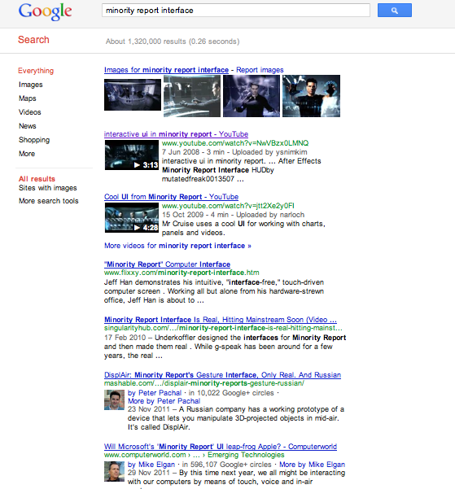
Minority Report

Slide 16
Minority Report
Videos from the film

Slide 17
Minority Report
Videos from the film
TED talk

Slide 18
Minority Report
Videos from the film
TED talk
Commentary using the film interface as a benchmark

Slide 19
Microsoft
“Future Vision of Productivity” (2015):
https://www.youtube.com/watch?v=w-tFdreZB94

Slide 20
Fantasies
The magical
The mythical
Government services
Critical design
Free & Open Source software
Scientific instruments
Techno-Art Installations
Special FX
R&D experiments
Design Fiction
desirable
Conventional products
Fraud
Complex derivatives
Theft
Vapourware
buildable
profitable
Loss-leaders
Unused technical capacity
Out-of-patent tech
The obsolete(?)
Weapons
Niche products
Criminal tech
Adapted from a diagram by Bruce Sterling, 2011

Slide 21
‘Diegetic prototypes’
“cinematic depictions of future technologies are what I term diegetic prototypes that demonstrate to large public audiences a technology’s need, benevolence and viability”
“Diegetic prototypes have a major rhetorical advantage even over true prototypes: in the fictional world – what film scholars refer to as the diegesis – these technologies exist as ‘real’ objects that function properly and which people actually use”
(Kirby, 2010: 43)

Slide 22
Affective response
following Deleuze – affect is simultaneously a physical phenomenon & an ‘impersonal force’ ~ ‘substrate of feeling’ (Connolly 2002)
prospective experience - emerges from within sets of relations to disclose the creation of potentiality
‘trans-personal’ attunement to potential technologies ‘as if’ they already exist

Slide 23
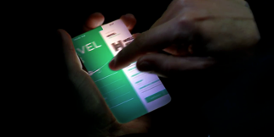
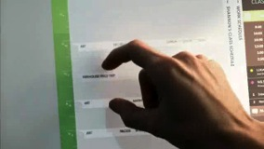
Affective response
Bodies
Touch
Gesture

Slide 24
Grammar
Worldly

Slide 25
Affective response
Minority Report: “I think the lay audience look at the technology in the film and say ‘Wow. Okay, I see how that works’. I think I could operate that myself in fact. I learned how from the film” – John Underkoffler
Apple iPad: “millions of people are going to be instantly familiar with it; they're going to know how to use it. In many ways, this defines our vision, our sense of what's next” – Jonathan Ive

Slide 26
Anticipatory practices
anticipatory practices ‘do more than gather the knowledge necessary to know futures’
anticipatory practices establish the presence of what has not happened and may never happen - an ‘indeterminate potentiality’ (Massumi, 2005)

Slide 27
Anticipatory practices
The “seemingly paradoxical process whereby a future becomes cause and justification for some form of action in the here and now” (Anderson, 2010: 778).

Slide 28
BBC R&D
“Leading the way” (2016):
https://www.youtube.com/watch?v=GYapPuPLG9o

Slide 29
Recap
Ideas about technology are frequently bound up with ideas about the future
Depictions of future technologies are political – they attempt to bring a future into the present to render it open to change
Depictions of ‘future’ technologies tell us more about today than ‘tomorrow’

Slide 30
“The best way to predict the future is to invent it”
—Alan Kay, 1971
“The future is already here, it’s just not evenly distributed”
—William Gibson (uncertain)

Slide 31
References
Anderson, B. 2010 "Preemption, Precaution, Preparedness: Anticipatory Action and Future Geographies" Progress in Human Geography 34 (6): pp. 777-798.
Bleecker, J. 2009 “Design fiction: A short essay on design, science, fact and fiction”, Near Future Laboratory, Los Angeles, CA.
Connolly, W.E. 2002 Neuropolitics: Thinking, Culture, Speed. Minnesota Press, Minneapolis, MN.
Genette, G. 1997 Paratexts: Thresholds of interpretation. trans. Lewin, J. E., Cambridge University Press, Cambridge.
Kirby, D. 2010 "The future is now: Diegetic prototypes and the role of popular films in generating real-world technological development" Social Studies of Science 40 (1), pp. 41-70.
Kitchin, R. & Kneale, J. 2001 "Science fiction or future fact? Exploring imaginative geographies of the new millennium" Progress in Human Geography 25 (1), pp. 19-35.
Massumi, B. 2005 “Fear (The spectrum said)”, Positions-East Asia Cultures Critique 13 (1), pp. 31-48.
Novas, C. 2006 “The political economy of hope: Patients’ organizations, science and bio-value”, BioSocieties, 1: pp. 289–305.
Shedroff, N. & Noessel, C. 2012 Make It So: Interaction Design Lessons from Science Fiction Interfaces. Rosenfeld.

