Slide 1
Digital Economies
GEO 3146 Digital Geographies

Slide 2
Today
Explore the ways economies are performed with and through digital media.
Think about digital media (especially social media) as means of gathering, channelling and monetising attention.

Slide 3
Labour

Slide 4
Digital labour?
Labour (and/or) work are a significant lens for the social sciences when thinking about the ‘digital economy’.
In part this because of a ‘labour theory of value’.

Slide 5
‘Immaterial labour’
Understanding ‘labour power’ as the source of economic value – what is sold by ‘free wage worker’ to ‘capitalists’ in a market.
Immaterial labour: digital technologies ‘change the relationship between the intellectual content of work and its material execution’ (Berardi, 2001: 51)

Slide 6
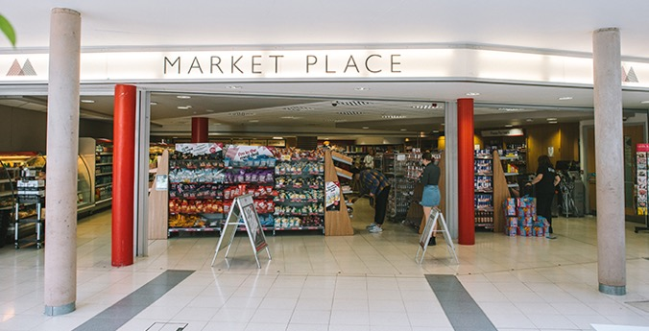
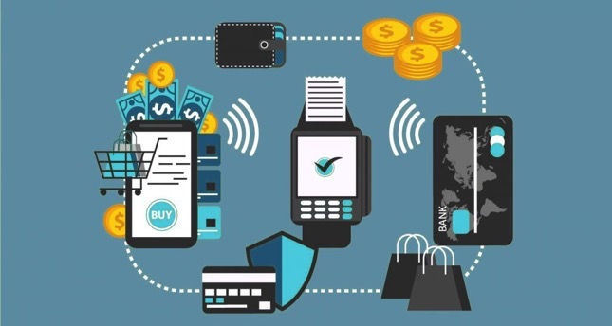
Platforms

Slide 7
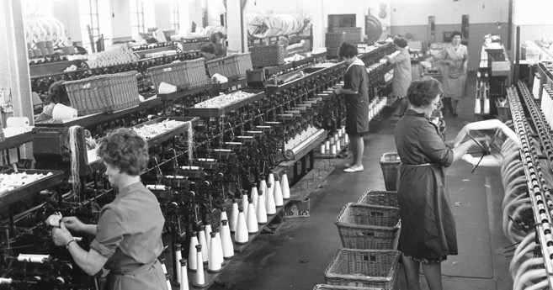
Platforms

Slide 8
Platforms
‘Unfulfilled’ – South Park (2019)
https://www.youtube.com/watch?v=_0BmWh1zZPk

Slide 9
Turkers
‘Turkers’
https://www.youtube.com/watch?v=BiPm9Esx4DE

Slide 10
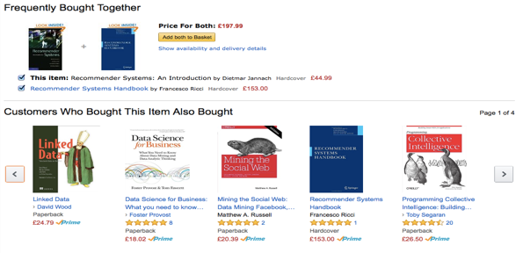
Consumer as worker
Software produces new kinds of labour
The data-driven economy relies on the labour of the consumer
reviews & ratings
captured habits
identifying problems

Slide 11
ATTENTION ECONOMY

Slide 12
‘Celebs, brands and fake fans’ – Dispatches, Channel 4
https://www.youtube.com/watch?v=jer2HH8HHfQ

Slide 13
Economising attention
[T]he wealth of information means a dearth of something else: a scarcity of whatever it is that information consumes. What information consumes is rather obvious: it consumes the attention of its recipients. Hence a wealth of information creates a poverty of attention.
(Simon, 1971: 40)

Slide 14
Economising attention
We are drowning in information, yet constantly increasing our generation of it. [...] There is something else that moves through the Net, flowing in the opposite direction from information, namely attention.
(Goldhaber, 1997)

Slide 15
Identity work
“On Instagram, people do not have equal access to this “star system” of attention as currency. Users often “like” what they find “aspirational”: marketing jargon for something people desire to own but usually cannot. …rather than overturn the traditional hierarchies of fame, the Instafamous reinforce them by appealing to audiences using the familiar trappings of thin but buxom bodies, sports cars, and designer clothes.”
(Marwick 2015: 157)
http://mediakix.com/2018/09/top-creative-instagram-influencers-design

Slide 16
disciplined definitions
Political economy:
Equating attention with labour
‘labour itself becomes “a subset of attention, one of the many kinds of possible attention potentially productive of value”’ (Clough, 2003: 361 citing Beller, 1998: 91).

Slide 17
attentive media
What we understand as capacities to ‘pay attention’ are largely mediated
Interactions are data, thus recorded
Some of the information presented is organised according to programmes using that data
Data are aggregated and used for ‘editorial’ decisions about how information is served

Slide 18
Tracking
Facial analysis and tracking:
https://vimeo.com/192457702
See also:
http://networkcultures.org/longform/2017/01/25/choose-how-you-feel-you-have-seven-options

Slide 19
Code intervenes
These are not neutral activities and the software is written to actively intervene, e.g. things like:
Amazon recommender system
Google Pagerank and Adwords
Twitter’s ‘algorithmic’ feed
Facebook Open Graph and Edgerank

Slide 20
Facebook Open Graph
Protocol for marking up websites
Designed to facilitate connections between people and things
An Application Programming Interface (API)
Opening the platform to connections to and between any online entity
Social ‘plug-ins’
The ‘like’ button

Slide 21
Open graph
http://www.pivotcon.com/5-ways-facebooks-open-graph-impacts-your-marketing/

Slide 22
Edgerank
Σ u_{e} w_{e} d_{e}
Where:
u_{e} is the ‘affinity’ between the nodes of relationship ‘e’
w_{e} is a weighting of the ‘content’
d_{e} is a timed decay

Slide 23
‘Like’ it
Open graph API facilitates ‘like’ buttons on any web page
Counts towards the ‘social graph’
Establishes links between ‘nodes’ in the graph
Provides persistent links
Used to infer value
Edgerank uses these interactions to cultivate (or replace) particular forms of attention

Slide 24
Edgerank
Organisation of information according to calculated weightings of popularity
Presumptions about nature of relationships
Temporal pressure
Simulating the filtering processes of attention

Slide 25
‘attention capture’
“TF1’s job is helping Coca-Cola, for example, to sell its product. What we sell to Coca-Cola is available human brain time.”
Patrick LeLey (TF1 CEO)
Notes:
Measurement of proxies for interaction:
a media ecosystem delivers ‘attention’ to advertisers / consumption through advertising metrics, e.g. cost- per-acquisition, cost-per-thousand-viewers
context or nature of attention rendered is ignored: as long as a quantifiable metric is achieved the cost remains the same

Slide 26
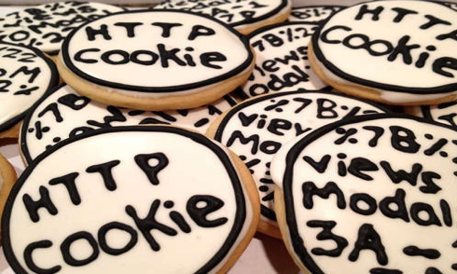
cookies
In order to model attention over time, we need to be traceable:
Data is stored on devices as ‘cookies’ that act as a unique ID for you in databases ~ makes you identifiable
The cookie is the enduring token, the ‘impression’ is the proxy-measure

Slide 27
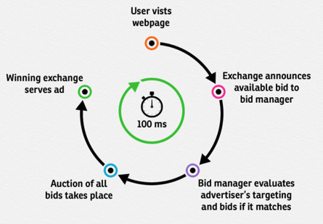
serving internet adverts
Much of the economic rationale of the internet is based on acting upon those measures to serve adverts
Performed through ‘real-time’ bidding for adverts as a page loads (milliseconds) based on data about the user

Slide 28
individual / collective
“I'll consume my consumers, with no sense of humour”
Grace Jones, Corporate Cannibal
Tendency to see attention in terms of the individual
Rhetoric of data– ‘double’, ‘exhaust’, ‘shadow’ from which value is extracted
Rhetoric of personalisation

Slide 29
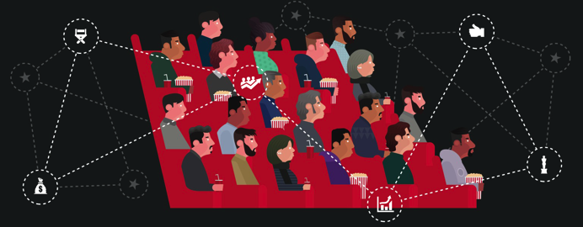
individual / collective
All personalisation requires modelling us as a class, category or ‘type’ – e.g. segmentation.

Slide 30
Labour Theory of Value & attention
An “attention economy” ‘consumes not only work time but also nonwork time or living time… [T]he crisis of the [attention economy] is determined by the contradiction between economic time and living time’ (Marazzi, 2008: 146)

Slide 31
attention & rent
Thinking about collectives:
Aggregate data, and access to the markets it defines, is the resource over which monopoly rent can be extracted.
Ad-serving exchanges/systems extract rent from [a model of] attention.
But…
Contradiction in the ‘uniqueness’ of the attention commodity and its replicability as a ‘type’.

Slide 32
Recap
We cannot assume that the platforms through which we are communal are neutral.
Software is written to directly intervene in and measure how we relate to one another, and this is given monetary value.
We have to remain critically aware of all of these things.

