Slide 1
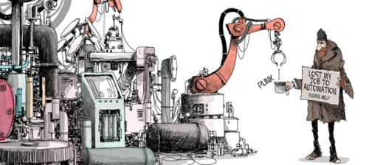
Working in a digital age
GEO 3146 Digital Geographies §8

Slide 2
Today
Explore how networked technology create new kinds of work
Critically reflect on how such technologies reconfigure existing forms of work
Think about how some kinds of work are disappearing

Slide 3
Telecommuting
“The home is the place where laboring identities are produced and reproduced on an individual and generational scale”
“The mainstream adoption of the home office as a normal expectation indicates that… the private sphere now takes some of the utilitarian considerations of the public”
(Gregg 2011: 136)

Slide 4
Digital body work?
“On Instagram, people do not have equal access to this “star system” of attention as currency. …the Instafamous reinforce [this] by appealing to audiences using the familiar trappings of thin but buxom bodies, sports cars, and designer clothes.”
(Marwick 2015: 157)

Slide 5
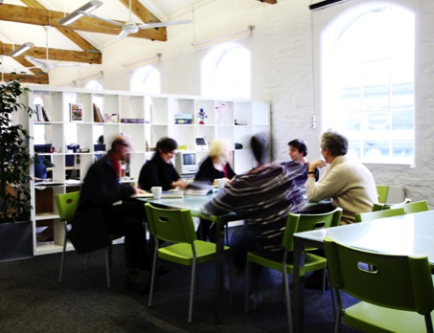
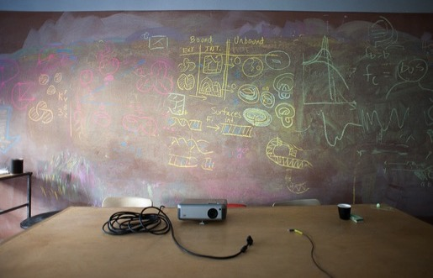
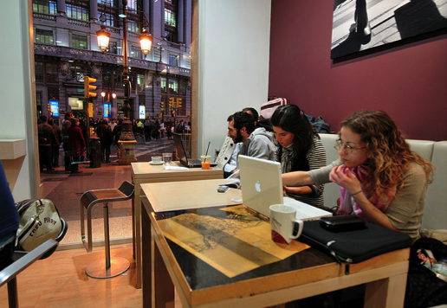
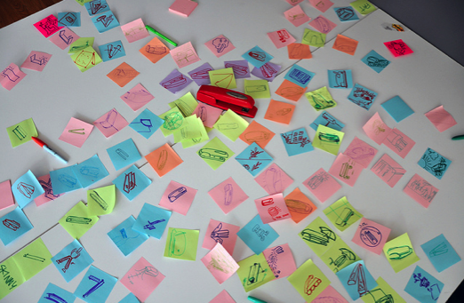
‘Post-industrial landscapes’

Slide 6
Surveillance

Slide 7
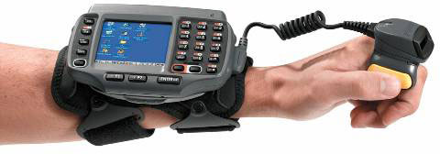
Surveillance in ‘customer fulfilment’
Arm-mounted terminals managed by warehouse management systems (programmes)
  Instructs pickers/ loaders
  Surveils pickers/ loaders
  Constructs a measure of productivity

Slide 8
Surveillance in ‘customer fulfilment’
Amazon:
  Daily targets: load/pick n per hour
  Targets keep rising
  ‘Three strikes’
  Checks for unscheduled breaks
Policy/rules are coded: programmatic policy directs (lower-level) management

Slide 9
Amazon in the UK
“The Truth behind the Click”, BBC Panorama, 2013:
https://www.youtube.com/watch?v=dw4hMw-9leE
Notes:
This is taken from an episode of the BBC’s Panorama in 2013.

Slide 10
Precarious?
Clip from Zero Hour – Deliveroo in Brighton (2017, YouTube Documentary):
https://www.youtube.com/watch?v=ojBHfL-nYQ8

Slide 11
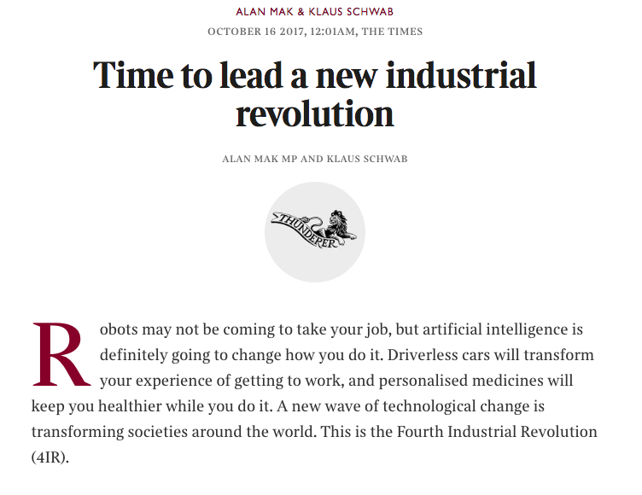
Epoch
https://www.thetimes.co.uk/article/time-to-lead-a-new-industrial-revolution-chlsfhtvl

Slide 12
Epoch
https://tradevistas.csis.org/industry-4-0-trade-rules-internet-things/

Slide 13
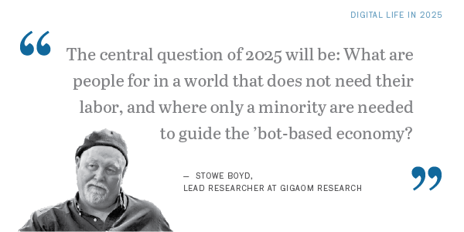
An economic story
Temptation to see automation as reduction of labour
but… it’s not so simple.

Slide 14
Automation anxiety
A video montage of BBC coverage of automation:
http://www.samkinsley.com/2018/07/19/40-years-of-automation-anxiety-in-the-uk-through-bbc-clips-video/

Slide 15
Automation anxiety
Video: montage of excerpts from BBC documentaries over time making claims about automation

Slide 16
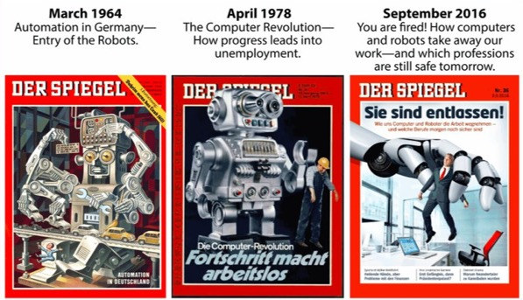
Automation anxiety
“Whatever the future holds, the present clearly offers a resurgence of automation anxiety”
(Autor, 2015: 4)

Slide 17
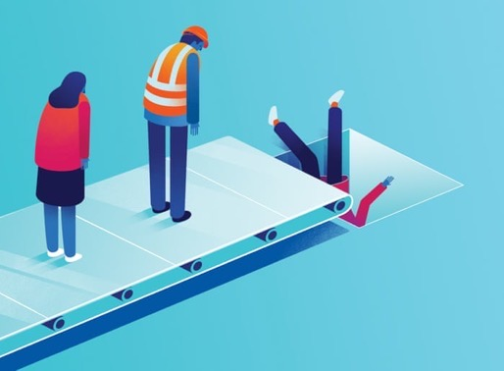
An old story
“We are being afflicted with a new disease of which some readers may not yet have heard the name, but of which they will hear a great deal in the years to come – namely, technological unemployment.”
(Keynes, 1931: 325)

Slide 18
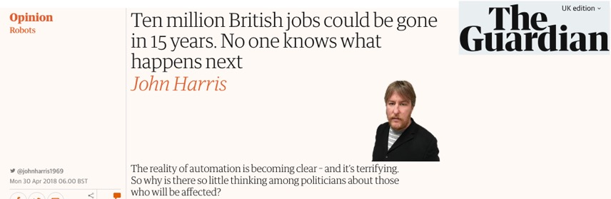
Risks
https://www.theguardian.com/commentisfree/2018/apr/30/reality-automation-terrifying
https://twitter.com/kevin2kelly/status/721790341527896065

Slide 19
An economic story
A return to ‘Post-Fordism’:
  ‘Offshoring’ & casualisation rather than ‘automation’
    Market mediated employment, anti-unionism, individualisation
  Work intensification ~ neo-Taylorism
…but specifically in relation to ‘service’ labour

Slide 20
Different kinds of labour
In the same system BOTH:
  Heavy vertical integration, Just-in-Time, ‘lean’ practices
AND (not OR)
  Flexible, specialised, ‘offshore’, individualised, market-mediated labour

Slide 21
Amazon
“an algorithmically managed infrastructure company”
— James Bridle
A sociotechnical assemblage to manage customers, buildings, other companies, stock, workers etc. for profit

Slide 22
Automation?
A ‘palatable’ alternative is being promoted: automating the movement across the warehouse.
Refining the movement of the ‘picker’.

Slide 23
Connotations
Consignment to redundancy
Freedom from drudgery
Increased productivity
…a mark of progress?

Slide 24
Automation
Automation is (more-or-less) oriented towards machinic uniformity
    E.g. the production line & ‘computer says no’

Slide 25
COMPUTER SAYS…
Video: An excerpt from the Little Britain sketch show featuring the character Carol Beer
https://youtu.be/mWBFDhNFhJw
Notes:
A humorous example is David Walliams’ character Carol Beer who in Little Britain has a blithe and unbending deference to the computer – which simply “says no”. The whole premise of the joke presented by that catchphrase is that, of course, there should be room for interpretation. Yet we are presented with a blind adherence to the results of the programme – which is patently stupid. Nevertheless, in many moments of everyday life we are presented with such forms of adherence to nonsensical outputs from software. Think of the many drivers who get stuck when rigidly following their GPS. We may even feel compelled to be complicit.

Slide 26
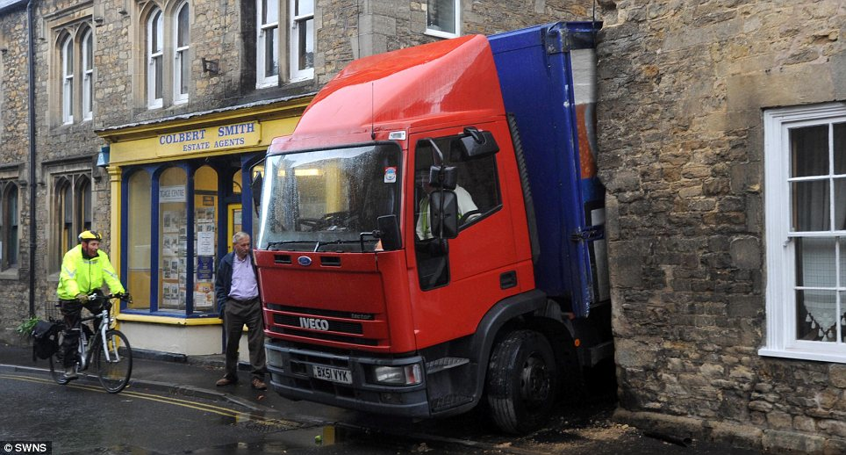

Slide 27
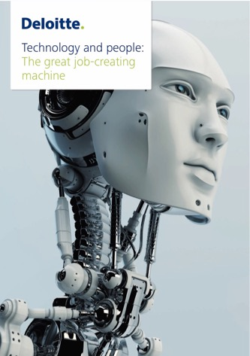
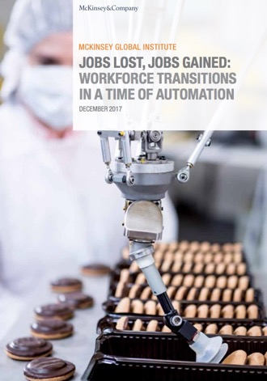
Business of “impacts”

Slide 28
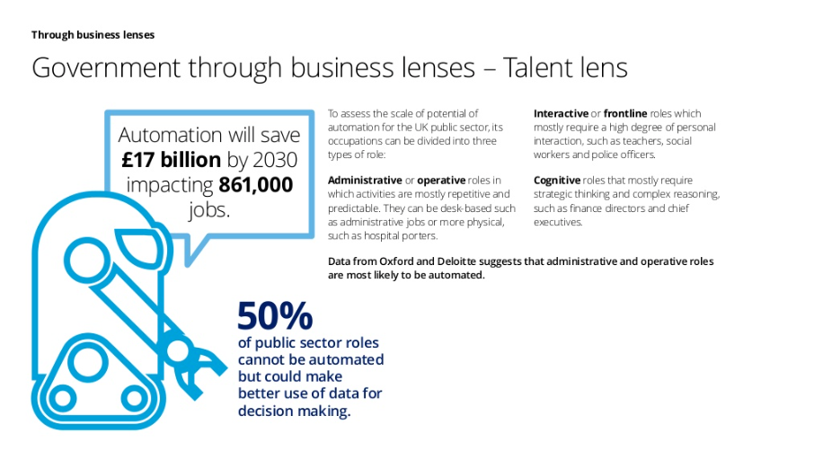

Slide 29
Journalists beware…
“Things looked bleak for the Angels when they trailed by two runs in the ninth inning, but Los Angeles recovered thanks to a key single from Vladimir Guerrero to pull out a 7-6 victory over the Boston Red Sox at Fenway Park on Sunday.”
“The University of Michigan baseball team used a four-run fifth inning to salvage the final game in its three-game weekend series with Iowa, winning 7-5 on Saturday afternoon (April 24) at the Wilpon Baseball Complex, home of historic Ray Fisher Stadium.”
One of these is written by a computer programme…
Notes:
Computer = top.
https://www.nytimes.com/2015/03/08/opinion/sunday/if-an-algorithm-wrote-this-how-would-you-even-know.html

Slide 30
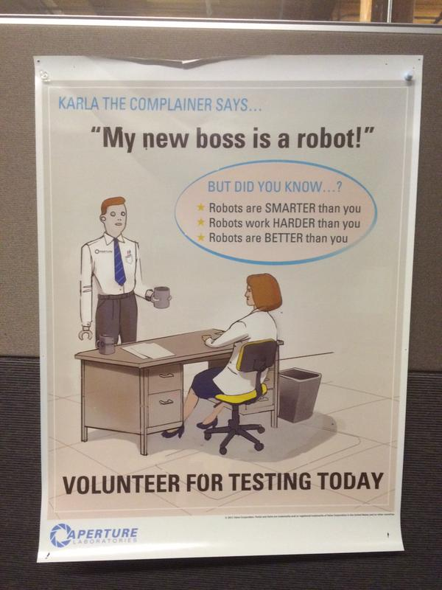
Turkers: labour ‘as a service’
Amazon ‘Mechanical Turk’
  “You’ve heard of software-as-a-service. Now this is human-as-a-service” —Jeff Bezos, 2006
  Establishes ‘workers as a form of infrastructure, rendering employees into reliable sources of computational processing’ (Irani & Silberman, 2013)

Slide 31
Turkers
“Turkers for a living: The world of Amazon’s marketplace for work”, The New Yorker
https://www.youtube.com/watch?v=BiPm9Esx4DE
Notes:
This video produced by The New Yorker in 2015 offers an insight into the kinds of people that work through Mechanical Turk and gives a sense of why and what they feel about it.

Slide 32
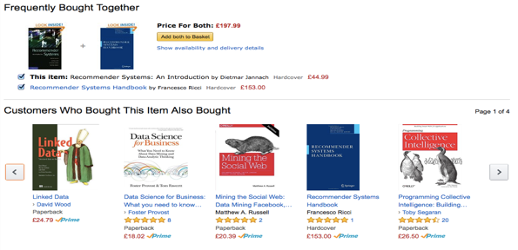
Consumer as worker
Software produces new kinds of labour
The data-driven economy relies on the labour of the consumer
reviews & ratings
captured habits
identifying problems

Slide 33
‘Click farms’
https://www.youtube.com/watch?v=hsCJU9djdIc
Notes:
What the business model of measuring people’s interactions with digital media can lead to then is the gaming of the system. If we recognise that a ‘click’ is worth something then some people might want to pay for it. Thus we arrive at a system whereby it is possible to buy an apparent status, if that status is measured through ‘followers’, ‘likes’ and so on. Likewise then the actual acts of ‘clicking’ literally require some form of work and so it does eventually boil down to labour.

Slide 34
Recap
Automation is happening, but not as fast as the technologists’ ‘dream’ (beware tech. determinism)
Lots of forms of work are affected by the logic of software
Our ways of interacting with the world through digital media can increasingly be seen as within regimes of ‘work’

