Slide 1
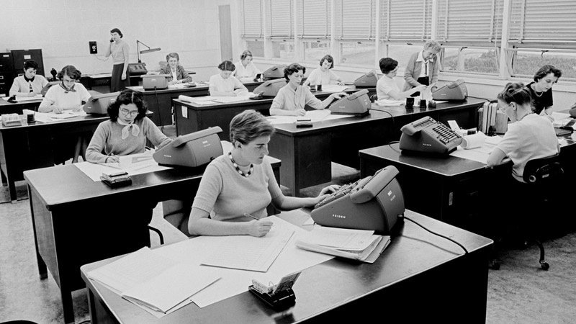
Digital (and) Difference
GEO 3134 Geographies of Technology §5

Slide 2
today
Technology’s relation to difference as:
  Personal – tied to the production and performance of identity
  Discipline – constitutive of raced/gendered ‘class’
  Emancipatory – enabling things to change

Slide 3
politics

Slide 4
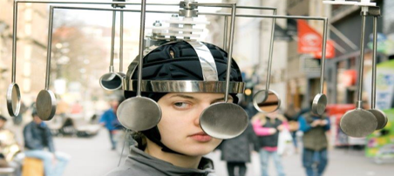
technologies of the self
Techniques that allow individuals to conduct particular kinds of operations on their own bodies, minds, souls, and lifestyle, in order to transform themselves to attain a certain state of wellbeing (Foucault: History of Sexuality)
Notes:
Foucault, M. 1978 The History of Sexuality Volume 1: An Introduction, New York: Pantheon.

Slide 5
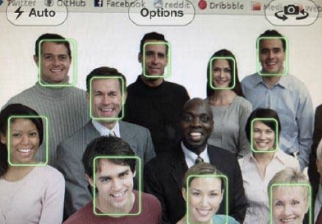
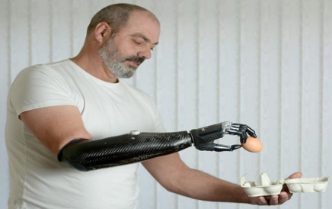
technologies of the self
Beyond ‘biology as destiny’ (Rose, 2001)?
Notes:
Rose, N. 2001 “The Politics of Life Itself”, Theory, Culture & Society 18(6): pp. 1-30.

Slide 6
bodies

Slide 7

body image

Slide 8
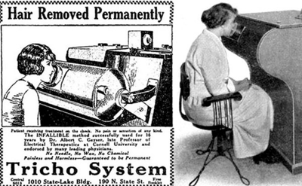
body image
Notes:
Herzig, R. 2003 “Situated technologies: Meanings”. In: Lerman, N et al. eds. Gender & Technology. A Reader. Baltimore: Johns Hopkins University Press: pp. 72-97.

Slide 9
Body image
Google Pixel 6 advert:
https://www.youtube.com/watch?v=xMZaObIQps8

Slide 10
Racist soap dispenser
https://www.youtube.com/watch?v=0-PZI_04bWc

Slide 11
Who is recognized?
AI ain’t I a Woman? – Joy Buolamwini
https://www.youtube.com/watch?v=QxuyfWoVV98

Slide 12
identity

Slide 13

stereotypes

Slide 14
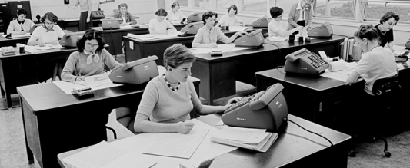
computers
Notes:
http://www.philsoc.org/2001Spring/2132transcript.html
https://www.youtube.com/watch?v=CE4Tf4JVl-E

Slide 15
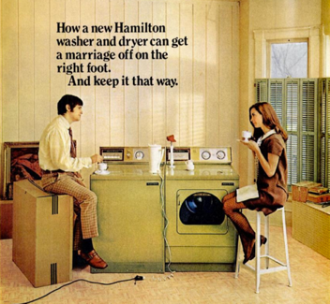
Freedom?

Slide 16
Assistants
♀︎
♀︎
⚤
♀︎
“Alexa”
“Home”
“Siri”
“Cortana”

Slide 17
Assistants
UNESCO (2019: 116) “I’d blush if I could” Report [adapted]

Slide 18
Gendering
iPhone advert
https://www.youtube.com/watch?v=SZflbbzZaIo

Slide 19

♀︎
♂
Schnoebelen (2016) “The Gender of AI”

Slide 20
Misogyny
Clip from South Park (series 21, episode 2) “Put it Down”

Slide 21
“Consistently representing digital assistants as female…hard-codes a connection between a woman’s voice and subservience.”
Jessica Nordell, New Republic (2016)

Slide 22
Why do we give robots female names? Because we don’t want to consider their feelings
Laurie Penny, New Statesman
Notes:
Feminists though, like Laurie Penny, disagree. The design is amplifying some of our society’s worst tendencies. Making into code unspeakable things. “the earliest bots and digital assistants were designed to appear female, in part so that users, who were presumed to be male, could exploit them without guilt.”

Slide 23
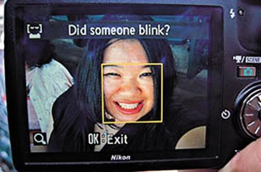
Encoded biases

Slide 24
Racist algorithm?
CBS News story:
https://www.youtube.com/watch?v=KYYVjT0mQB8

Slide 25
Biases

Slide 26
recap
Digital technology is a key element to the construction and performance of difference and differentiated bodies.
Digital technology has been both a tool for disciplining according to ethnicity and gender and for emancipating us from it.

