Slide 1
Digital Questions
DIGITAL GEOGRAPHIES

Slide 2
Today
The ‘big’ questions raised by digital media and technology

Slide 3
WHO ‘OWNS’ OUR DATA?
SURVEILLANCE CAPITALISM

Slide 4
Surveillance Capitalism?
‘What is Surveillance Capitalism?’ – Shoshana Zuboff
https://www.youtube.com/watch?v=fwNYjshqZ10 un

Slide 5
Surveillance Capitalism
What is the ‘product’?
Who are the ‘customers’?
Does it actually ‘work’?

Slide 6
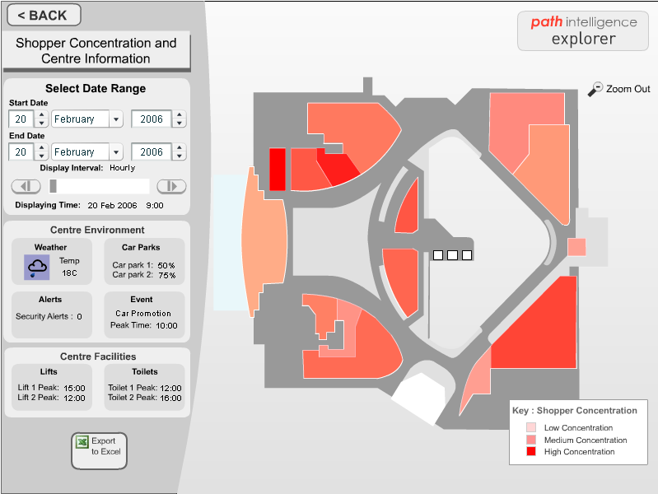
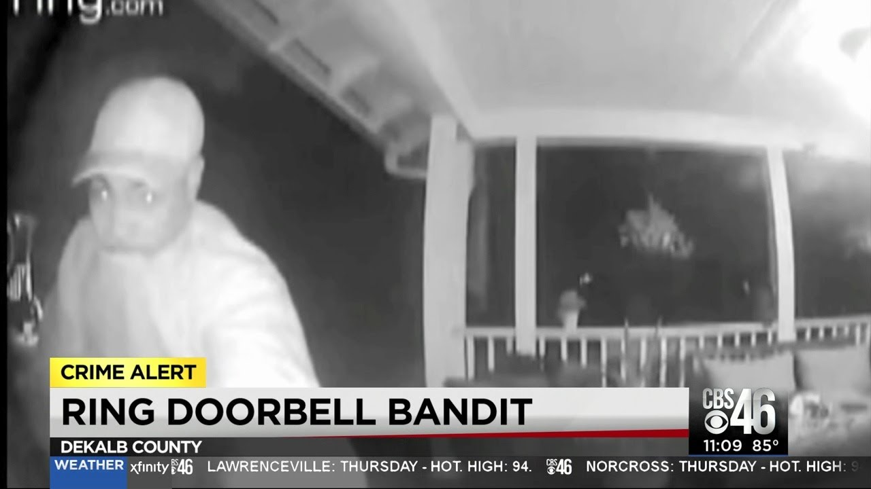
Surveillance Capitalism

Slide 7
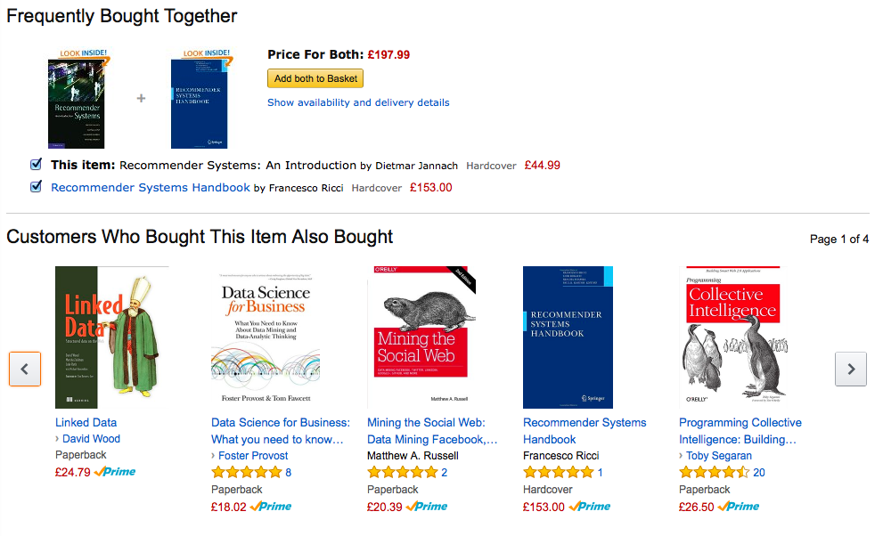
Consumer as worker
The data-driven economy relies on the labour of the consumer
reviews & ratings
captured habits
identifying problems

Slide 8
Data
The Data Dollar Store – Kaspersky
https://www.youtube.com/watch?v=dqcHcnpNHIM

Slide 9
Whose Identity?

Slide 10
Data, Again
Data to Go – Cifas
https://www.youtube.com/watch?v=sq-0tjv4_BA

Slide 11
Catfish
What is Catfishing? – BBC News
https://www.youtube.com/watch?v=JPuaOCiVAh0

Slide 12
Whose ‘Truth’?
FAKE NEWS

Slide 13
fake news
A clip from a video charting the rise of teenagers in Macedonia creating ‘fake news’:
https://www.youtube.com/watch?v=0F7BT-mZFTw
https://www.wired.com/2017/02/veles-macedonia-fake-news/

Slide 14
‘Filter bubbles’
Very short excerpt from Eli Pariser’s TED talk on his book “The Filter Bubble”:
https://www.youtube.com/watch?v=4kkG3KdgfCY

Slide 15
“Truth”
In many ways the ‘filter bubbles’ we all inhabit are ‘regimes of truth’ (Foucault)
Subject to forms of ‘confirmation bias’
In which we are integral to their function

Slide 16
London riot rumours
London Riot Rumours – The Guardian:
https://www.theguardian.com/uk/interactive/2011/dec/07/london-riots-twitter

Slide 17
Final Thoughts

Slide 18
So what…?

Slide 19
POWER
SPACE
PLACE
OWNERSHIP
IDENTITY
WORK
TRUTH
VALUE
COMMUNITY

