Slide 1
DIGITAL CITIES
DIGITAL GEOGRAPHIES

Slide 2
Today
Exploring the ways digital connectivity is being integrated into (almost) everything.
Asking what this means for urban life.
Critically interrogating how an ‘Internet of Things’ can be understood politically & culturally.

Slide 3
Software & the city
The city is composed of “constellations of instruments across many scales that are connected through multiple networks which provide continuous data regarding the movements of people and materials” (Batty et al. 2012: 482)
“The modern city exists as a haze of software instructions. Nearly every urban practice is becoming mediated by code” (Amin & Thrift, 2002: 125)

Slide 4
Instrumented people, places & things
Extensive information & comms networks:
‘everyware’ (Greenfield, 2006): ubiquitous/pervasive computing available everywhere, embedded in lots of things
Social & locative media
Distributed & ‘forever’ storage
Sophisticated data analytics
Software-enable automated management (automatic, automated, autonomous modes of regulation)
= smart city

Slide 5
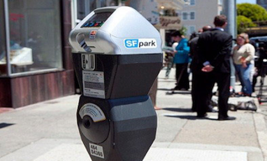
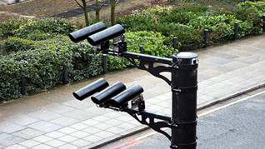
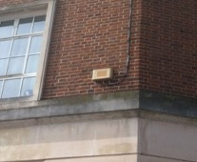
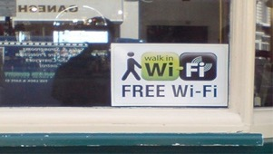
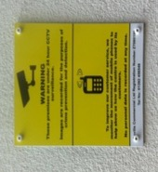
Software in the city

Slide 6
‘Coded space’
Software diffuse in the environment now conditions forms of spatial experience:
‘coded space’
(Kitchin & Dodge, 2011)
Spaces penetrated by IT
Do not necessarily rely on it to function

Slide 7
‘code/space’

Slide 8
Smart cities = big business
IBM “Smarter Planet” promotional video:
https://www.youtube.com/watch?v=Vx0wEUA6bLM

Slide 9
Data

Slide 10
Surveillance
Clip from the “Path Technology” promotional video by Path Intelligence:
https://vimeo.com/114756123

Slide 11
Data produce…
What/who is the ‘product’ of a data-driven market?
Do data represent or enact a world?
When and where? And can we access/observe this?

Slide 12
A politics of smart cities
Data often presented as ‘neutral’, natural/essential measures
Sensors/algorithms have no politics or agenda, they reflect & produce truths
This framing allows a benign common-sense story for ‘smart cities’

Slide 13
A politics of smart cities
However:
Data are never neutral – cannot exist independently of the ideas, techniques & technologies, people & contexts that conceive, produce, process, manage, analyse and store them
“Raw data is an oxymoron”

Slide 14
Location-based services

Slide 15
Location, location, location
2001ish European Location-Based Services: → bars, food, taxis → SMS FriendFinder US Location-Based Services: → AT&T Find Friends

Slide 16
Location, location, location
2001ish European Location-Based Services: → bars, food, taxis → SMS FriendFinder US Location-Based Services: → AT&T Find Friends
2005…
Google Earth
Google Maps API
Dopplr.com
Qype.com
Loopt.com
Brightkite.com

Slide 17
2001ish European Location-Based Services: → bars, food, taxis → SMS FriendFinder US Location-Based Services: → AT&T Find Friends
2005…
Google Earth
Google Maps API
Dopplr.com
Qype.com
Loopt.com
Brightkite.com
10 applications that make the most of location (from Biba 2009)
1 Drive fast, avoid the cops (locations of known speed traps): Trapster
2 Sleep easy, we’ll wake you (missing your stop on public transit): iNap
3 Play tag, with strangers: JOYity
4 Call a cab, the easy way (location-aware cab services): Cab4Me
5 Scan a barcode, find a deal (local deals): ShopSavy
6 See the world, through Google’s eyes: Google Earth
7 Train your phone to know its place (location-aware phone ringer settings): Locale
8 Look Up! Be a stellar student (what stars are above): GoSkyWatch
9 Dark Alley? Call for help (location-aware alarm system): SafetyNet
10 Go here when you gotta go (location-aware facility finding): SitOrSquat

Slide 18
March 2009 → foursquare Launch

Slide 19
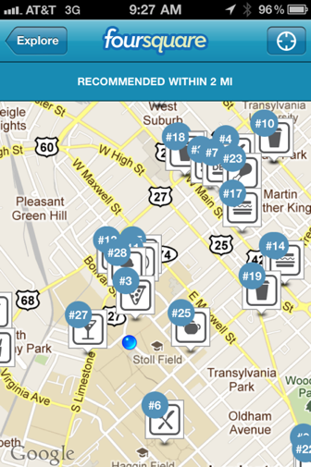
explore

Slide 20
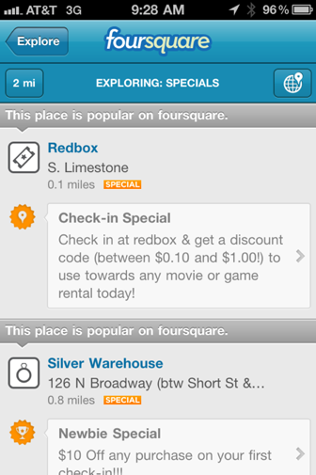
“Check-in specials”

Slide 21
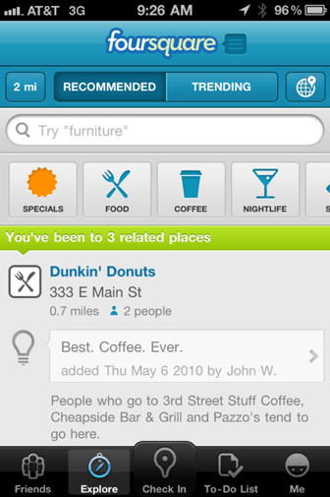
RECOMMENDATIONS

Slide 22
10,000,000 FOURSQUARE USERS
(15 JULY 2011)

Slide 23
What work did 4SQ do?
4SQ → individualisation of urban experiences
4SQ → enables/demands/rewards consumer activity
“GAMIFICATION”
Notes:
BOGOST:
“Gamification is reassuring. It gives Vice Presidents and Brand Managers comfort: they’re doing everything right, and they can do even better by adding “a games strategy” to their existing products”
It is “simple, repeatable approaches in which benefit, honor, and aesthetics are less important than facility”

Slide 24
What work did 4SQ do?
Gamification for data?
4SQ → customers are also resources (data)
4SQ → facilitates the capturing of ‘attention’
Notes:
4SQ: ” In 2014, Foursquare launched Pilgrim, a piece of code that passively tracks where your phone goes using Bluetooth, Wi-Fi, GPS, and GSM to identify the coffee shop or park or Thai restaurant you’re visiting, then feeds that data to its partner apps to send you, say, an offer for a 10 percent off coupon if you leave a review for the restaurant. Today, Pilgrim and the company’s Places API are an integral part of tens of thousands of apps, sites, and interfaces. As Foursquare’s website says, “If it tells you where, it's probably built on Foursquare.””
BOGOST: “Exploitationware captures gamifiers’ real intentions: a grifter’s game, pursued to capitalize on a cultural moment, through services about which they have questionable expertise, to bring about results meant to last only long enough to pad their bank accounts before the next bullshit trend comes along.”

Slide 25
Video excerpt from:
https://www.youtube.com/watch?v=rtVACry48Oo&t=296s

Slide 26
Automation & connectivity

Slide 27
Things talk

Slide 28
IoT questions
Questions of ownership/responsibility:
Whose things?
Whose data?
Who has access? How? When? Where?
Questions of power:
How are decisions made on the basis of the data?
How doe these decisions influence our lives?

Slide 29
Internet of Things (IoT)
Clip from Intel ‘Internet of Things’ promotional video:
https://www.youtube.com/watch?v=uEsKZGOxNKw

Slide 30
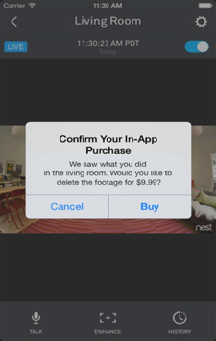
IoT by subscription

Slide 31
What is our data worth?
How can/should we negotiate the value(s) of our data?
What are we willing to give(-up) for perceived benefits?
When does giving away lots of data become not worth it?

Slide 32
Uninvited guests
I didn’t show this in the lecture but this is a fantastic, humorous, reflection on some of the themes covered:
“Uninvited Guests” speculative design video about “smart” products by Design Agency Superflux:
https://vimeo.com/128873380

Slide 33
Recap
‘Smart cities’ are being designed, and claims are being made about them – on which we need to critically reflect.
The ‘Internet of Things’ is both a rationale and a rhetoric for digital interconnectivity that raises important ethical/political & cultural questions
Especially about privacy, surveillance and value.

Slide 34
Recap
Both IoT and smart cities have been addressed by geographers as:
Software-sorted geographies, coded spaces, code/space
We are increasingly asked to consider the abstract forms of software as having agency, but need to be critically reflective of ‘algorithm’ talk

Slide 35
References
Amin, A. & Thrift, N. 2002 Cities: Reimagining the Urban. Polity, London.
Batty, M. et al. 2012 “Smart Cities of the Future”, UCL Centre for Advanced Spatial Analysis Working Paper Series #188 October 2012, pp. 1-40.
Speed, C. 2015 “Toilet Matters”, Fields [blogpost], available from: http://chrisspeed.net/?p=1529 (last accessed: 02/03/16).

