Slide 1
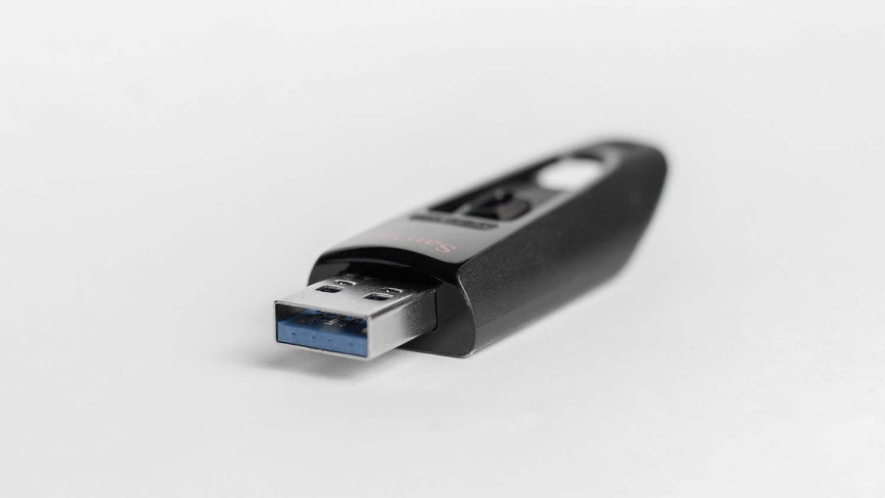
memory
Digital Geographies

Slide 2
Today
Explore how we support memory with writing and how this relates to being human

Slide 3
Memory
Excerpt from the film: ‘The Ister’:
https://en.wikipedia.org/wiki/The_Ister_(film)

Slide 4
Some history

Slide 5
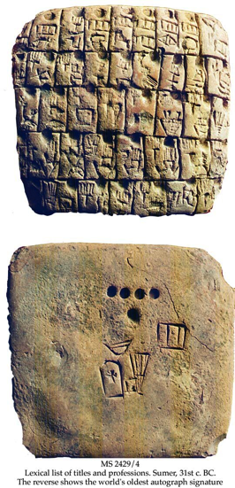
Writing as history
Writing as…
leaving your mark
the conveyor of meaning/ history
a dating mechanism

Slide 6
Notes:
Chauvet cave painting c. 30k years ago

Slide 7
Notes:
The Tărtăria tablets – neolithic pictograms known as Vinča symbols ~ proto-writing c.5500BC (contested)

Slide 8
Notes:
Cuneiform clay tablet, Sumeria, c. 3500BC

Slide 9
Notes:
Seal impression naming king Peribsen, 2nd Dynasty, Ancient Egypt c. 2800BC

Slide 10
Notes:
Rosetta stone ~ 200BC

Slide 11
Quick detour writing as an embodied act

Slide 12
Manual action

Slide 13
Hands

Slide 14
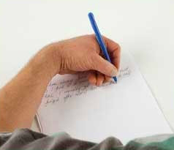
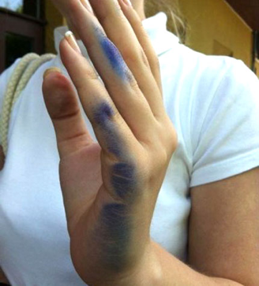
Hands

Slide 15
History as Mechanisation

Slide 18
Spatialised memory
The memory of the human entity is essentially exteriorised, materialised and spatialised
(Stiegler, 2012)

Slide 19
Notes:
Cuneiform clay tablet, Sumeria, c. 3500BC

Slide 20
It is spatially, materially and technically projected into what is constituted as a common space and time
(Stiegler 2012)

Slide 21
Notes:
Now London Gazette – official government record, continuously published since 1665.

Slide 22
projected if not out of time then at least beyond its own original temporality and in a certain way put into reserve in space, enabling it to become at once the memory of the individual and of the group.
(Stiegler 2012)

Slide 23
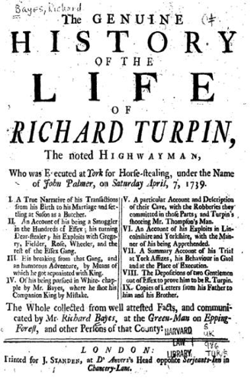
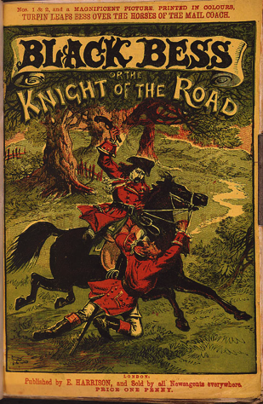
Notes:
Immediately turned into a sensationalised fable – first in Bayes 1739 book and later by victorians. Becomes a national myth.

Slide 24
grammatisation
The process of grammatisation is …a process of making the continuous discrete, something prefigured in this respect by the first systems of counting in the epoch of hieroglyphics before the appearance of grammata.
(Stiegler, 2012)

Slide 25
Notes:
Jaquard loom, c. 1800s

Slide 26
grammatisation
The writing of the grammata enabled the spatialisation to the letter of the time of speech. What I mean by ‘to the letter’ here is that speech could be reproduced wholly without ambiguity, at least in its semantic dimension if not its prosodic one.
(Stiegler, 2012)

Slide 28
Writing as pharmakon
Writing “will produce forgetfulness in the soul of those who learn it because they will cease to exercise their memory and will put their trust in what is written when they remember, in what is outside, in external print, instead of what is on the inside, in themselves;”
(Plato Phaedrus, 275a)
Notes:
Plato put Thamus, a king of Egypt, in dialogue with Thoth, Egyptian god of arithmetic, to argue over the merit of writing.

Slide 29
‘Fake News’
Video excerpt from the BBC:
https://www.youtube.com/watch?v=UAy6PI5UtSU

Slide 30
Writing as pharmakon
“therefore it is not memory (mnemès) but reminding (hypomnesis) for which you have found the remedy. As to knowledge, it is only the semblance of it that you procure for your disciples, and not the reality”
(Plato Phaedrus, 275a)

Slide 31
pharmakon
Phaedrus: writing as artificial memory (hypomnesis) opposed to the autonomy of thought (anamnesis) – it is ‘both a poison and a cure’: a pharmakon
Stiegler: this autonomy always has something to do with heteronomy (exteriorisation)
Plato opposes them, Stiegler argues they compose: opening transitional spaces of thought/feeling.

Slide 32
Not only words
Clip of a high-speed industrial robot:
https://www.youtube.com/watch?v=e9geaPrEW3E

Slide 33
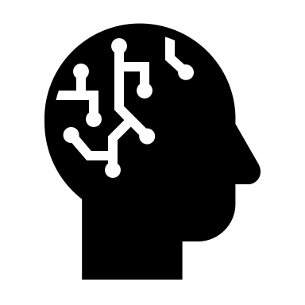
‘Pharmacology’
A ‘pharmacological’ thinking of the digital must study the contradictory dimensions of automatisation in order to counteract its destructive effects on knowledge.
(Stiegler 2013: 38)

Slide 34
‘Pharmacology’
The point is not merely to ensure that there is a right to access the internet, but of having a right and a duty to know (through education) that invisible automatisms exist, and that these … may manipulate [our] brains without [us] teaching [ourselves] how [our brains] should themselves be manipulated, how they should be handled.
(Stiegler 2013: 38)

Slide 35
To Conclude…
If memory is taken as a problem, then writing can be seen as a therapeutic technique to solve it. However, that ‘therapy’ is ambivalent – it is a ‘pharmakon’.

Slide 36
Recap
What makes us human is our spatialisation of thought through writing, digital media are the latest phase

Slide 37
Recap
Writing has been used as:
A way of leaving your mark/meaning
The conveyor of meaning/ history
A dating mechanism for charting history

Slide 38
Recap
Writing has, for >2000 years, been argued over as a kind of ‘pharmakon’ – both a ‘poison’ and a ‘cure’ for self-expression and memory

Slide 39
Recap
Writing has long been a ‘manual’ act but has become mechanised
There are some worries over this mechanisation, especially in terms of ‘the digital’

Slide 40
Recap
We can encode/signify more than phonetic words – writing can be a memory of actions, to be repeated (industrially)

